Slide 1
Unit 4: Week 3
Grade K

Slide 2
Copyright © Savvas Learning Company LLC. All Rights Reserved.
This publication is protected by copyright, and permission should be obtained from the publisher prior to any prohibited reproduction, storage in a retrieval system, or transmission in any form or by any means, electronic, mechanical, photocopying, recording, or otherwise. For information regarding permissions, request forms, and the appropriate contacts within the Savvas Learning Company Rights Management group, please send your query to:
Savvas Learning Company LLC, 15 East Midland Avenue, Paramus, NJ 07652
or
k12learningpermissions@savvas.com
myView Literacy® is an exclusive trademark of Savvas Learning Company LLC in the U.S. and/or other countries.

Slide 3
Lesson 1

Slide 4
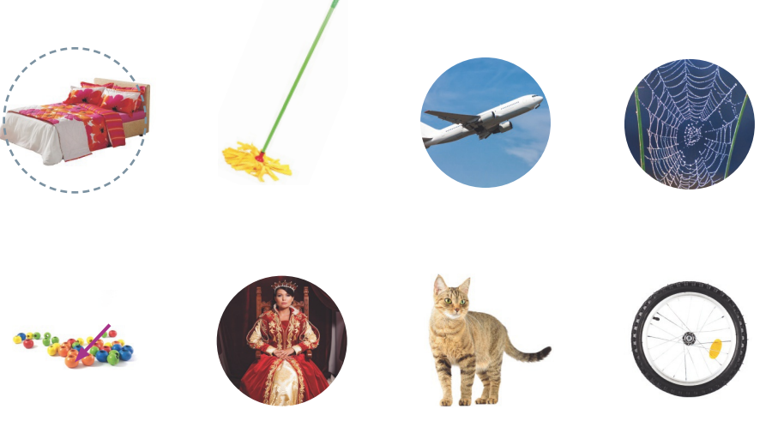
Page 92
Phonological Awareness
Notes:
Tell students that today they will learn a new sound. Listen carefully as I say the sound: /ē/ /ē/ /ē/. The sound /ē/ is made by opening your mouth slightly and pulling back the corners of your mouth. Have students practice saying the sound /ē/. Then review how to make the sound /e/.
Have students turn to p. 92 in the Student Interactive. Let’s look at the first row of pictures. We will circle picture words with the middle sound /e/. This is a picture of a bed, /b/ /e/ /d/. I hear /e/ in the middle of bed, so let’s circle the picture. Identify the other pictures in the first row and ask students to circle the picture words that have the sound /e/. Then identify the pictures in the second row and have students circle the picture words with the sound /ē/.

Slide 5
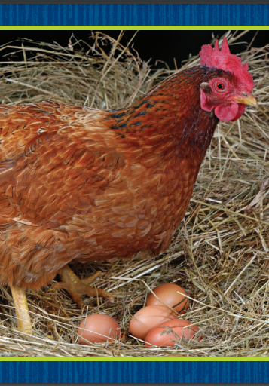
Phonics
Pete
e
e_e
Notes:
Hold up the hen Picture Card. Have students say hen with you. Let’s say the sound in the middle of the word: /e/ /e/ /e/. The middle sound /e/ is spelled with the letter e.
Write the word Pete. Have students say Pete with you. Let’s say the sound in the middle of the word: /ē/ /ē/ /ē/. The middle sound /ē/ is spelled with the pattern e_e.
Tell students that you will write words that have the sound /e/ or /ē/. Have students listen for the sounds /e/ and /ē/ as they read each word together. Tell them to raise their hands if they hear /e/ and touch their toes if they hear /ē/. Use the following words: jet, Steve, men, Eve, Pete, den.

Slide 6
Page 93
Phonics
Turn to page 93 in your Student Interactive.
Notes:
Have students look at p. 93 in the Student Interactive. Have them trace the e on the first set of lines. Read the first name with them. Then have students trace the letters e on the page and read the names. Have students draw lines to match the names with the same sound for e.

Slide 7
High-Frequency Words
black
white
brown
Notes:
Display the high-frequency words black, brown, and white.
Point to the word black and read it.
Have students point to the word black and read it.
Repeat for brown and white.

Slide 8
Page 90, 91
Interact with Sources
What questions do you have about phones?
Notes:
Remind students of the Essential Question for Unit 4: What can we learn from the past? Then introduce students to the Weekly Question: How has communication changed over time? Tell them that by thinking about how communication has changed over time, we can learn about the past.
Have students look at the images on pp. 90–91 in the Student Interactive. Read aloud the words past and present and explain that a time line can show how things have changed. Use the following prompts to guide a discussion:
Point to the pictures. Ask: What is in the pictures? What do you think the time line is about?
Have students look at the photograph on p. 90 and read the caption aloud. Explain that long ago, when someone wanted to make a telephone call, they had to first talk to an operator, who connected them with the person they wanted to call.
Read aloud the caption on p. 91. Explain that today many people use smartphones. Discuss with students how phones today differ from phones from the past.
Tell students that they can ask questions to learn more about interesting topics. Explain that students can ask questions about the information on the time line to learn more about how phones have changed.
Have students use the pictures and text on pp. 90–91 to generate questions for informal inquiry about phones. Provide assistance as necessary.
Remind students of the Weekly Question: How has communication changed over time? Tell students that a telephone is an invention that is used for communication. Review with students what they learned about phones. Ask them to describe the differences between old phones and modern phones.

Slide 9
Listening Comprehension
Story Elements Chart
Characters | Events
Story Events
Notes:
Tell students that they will listen to a story. Remind them that stories have a setting, which is where the story takes place. They have characters, story events, and a story problem. Have students listen as you read aloud the fiction text, “Bad Summer or Good Summer?” Prompt students to be active listeners by looking at you and thinking about what you are saying as you read aloud. Tell them to try to picture in their mind what is happening in the story.
Read the entire text aloud without stopping for the Think Aloud callouts.
Reread the text aloud, pausing to model Think Aloud strategies related to the genre.
Create a story elements chart. Discuss the story with students and have them help you fill in the story elements chart.

Slide 10
Page 104, 105
Fiction Qualities
Turn to page
104-105 in your Student Interactive.
Notes:
Tell students that fiction stories have characters, a setting, and plot events. Explain that knowing the parts of a story can help a reader understand it.
Characters are the people or animals in the story. They are who the story is about.
The setting is where and when the story happens.
The plot is the series of events in the story—it’s what happens in the story.
The characters, setting, and events in fiction are made-up.
Turn to the anchor chart on p. 105 of the Student Interactive and review the two parts of a story’s setting: time and place.
I just read aloud a story about a boy named Tommy. Tommy is a made-up character.
The setting is the place and time the story takes place. The story about Tommy happens outside his home. It also happens at the beginning of the summer. I know this because his friend, Jacob, had just left for summer camp.
Have students look at p. 104. Read aloud the text and work with them to identify the setting, characters, and plot in the story on this page. Editable Anchor Chart Click Path: Table of Contents -> Reading Anchor Charts -> Unit 4 Week 2: Narrative Nonfiction Editable Reading Anchor Chart

Slide 11
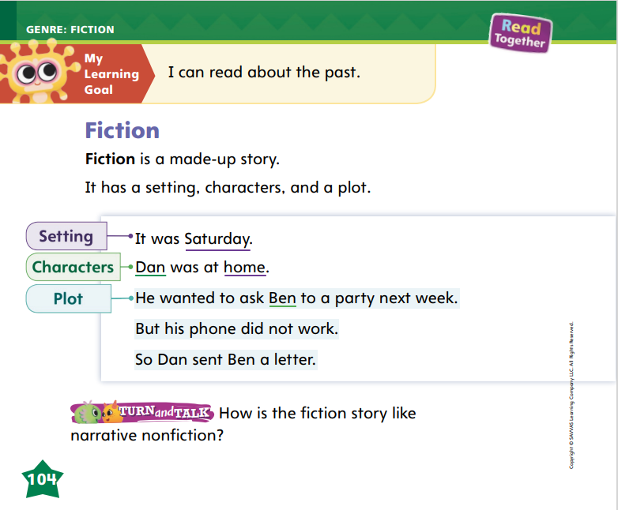
Page 104
Apply
How is the fiction story like narrative nonfiction?
Notes:
Have students use strategies for identifying characteristics of fiction.
Have students turn and talk with a partner about fiction and narrative nonfiction. Then have partners share their ideas with the class.

Slide 12
Page 121
Academic Vocabulary
Turn to page
121 in your Student Interactive and complete the activity.
Notes:
Tell students that using academic vocabulary they have learned as they read, speak, and write will help them better understand the words. Explain that students can use context clues to help them figure out the meaning of an unknown word as they read.
Look at the other words in the sentence to help you figure out the meaning of an unknown word.
Write I change my shirt from a red one to a blue one and model using context clues to figure out the meaning of the word change. I will look at the other words in the sentence to figure out the meaning of the word change. This sentence is about a red shirt and a blue shirt. If I have on a red shirt and then I put on a blue shirt, my shirt is different. Now I know that change means “to become different.”
Read aloud the second sentence on p. 121 with students, leaving out the missing word. Ask them to choose the word that makes sense and write it.

Slide 13
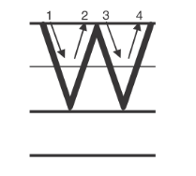
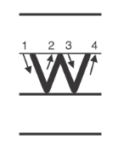
Handwriting
Notes:
Display uppercase and lowercase letters Ww and have students identify them. Point out that the shapes of the letters are the same, but the uppercase W is larger.
Watch as I write an uppercase W. Start at the top and draw a slanted line down to the bottom, a second slanted line up to the top, a third slanted line down to the bottom, and a fourth slanted line back up to the top. Then write the lowercase w. I write a lowercase w in the same way as the uppercase W, but the lowercase letter is smaller. It goes to the middle line instead of to the top. Have students trace the letters in the air and then on their hands.
Have students use Handwriting p. 204 from the Resource Download Center to practice writing Ww. Click path: Realize -> Table of Contents -> Resource Download Center -> Handwriting Practice -> U4W3L1 Handwriting Practice

Slide 14
Page 125
Writing – Personal Narrative
Turn to page 125 in your Student Interactive.
Notes:
Authors organize personal narratives by putting the events in their narratives in order. What happens first in a book is important because it often tells about the problem.
Choose a stack text and have students listen as you read to identify the first event in the story. Point out details in the pictures that show what happens first. When you finish, think aloud to recall and write down the events in the story. Point out what happened first in the book, and explain how this event introduced the problem and made you excited to keep reading.
Pull out another stack book and read it aloud. Have students recall the events in the story, specifically the first event. Ask how they felt about the first event and if it introduced the problem. Say: When we write our own personal narratives, we will organize the events so that the first event introduces the problem.
Direct students to organize ideas by completing the drawing activity on p. 125 in the Student Interactive.

Slide 15
Independent Writing
Reread the first event in the book you are writing to make sure it introduces the problem.
Share what happens first in your personal narrative.
Notes:
Have students reread the first event in the book they are writing and make sure it introduces the problem.
They can edit their first event in this book or other books they have written during this unit before continuing to write.
Writing Support
Modeled - Use stack texts to show what happens first.
Shared - Prompt students to tell about the first event in their own narrative.
Guided - Use a stack text to provide instruction on how to identify the first event..
Ask students to share what happens first in their personal narrative. Have students provide feedback if the first event introduced the problem.

Slide 16
Spelling
Ben has brown hair.
We met Grandpa at the carnival.
I like the color red.
Pam has black shoes.
Dad uses a pen to write a letter.
How high is the basketball net?
Notes:
(Note: Move the orange boxes to cover each bold spelling word before you read aloud the words and sentences.)
Read aloud the words and sentences. Have students spell each word with initial consonant blends and the two high-frequency words.
Ben has brown hair.
We met Grandpa at the carnival.
I like the color red.
Pam has black shoes.
Dad uses a pen to write a letter.
How high is the basketball net?
Reveal the spelling word and have students check their work.

Slide 17
Language and Conventions
I love cats.
Do you love cats?
Cats are awesome!
Which sentence is an asking sentence? Which is a telling sentence?
Which is an exclamation?
Notes:
Remind students that there are different kinds of sentences.
Write the following sentences: I love cats. Do you love cats? Cats are awesome! Read aloud the sentences with students and ask: Which sentence is an asking sentence? Which is a telling sentence? Which is an exclamation?
Pair students and have them take turns saying different kinds of sentences.

Slide 18
Lesson 2

Slide 19
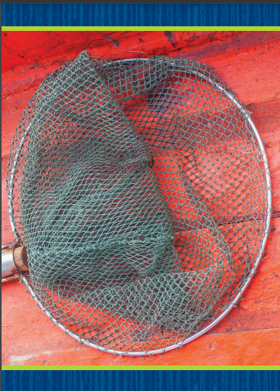
Phonics
e
e_e
jet
Steve
Notes:
Hold up the net Picture Card. Point to the picture of the net. Say: This is a picture of a net. Listen to the sounds in the word: /n/ /e/ /t/. I hear the sound /e/ in the middle of net. Say the sound /e/ with me: /e/.
Write Steve on the board. Say: This is the name Steve. Listen to the sounds in the word: /st/ /ē/ /v/. I hear the sound /ē/ in the middle of Steve. Say the word with me: /st/ /ē/ /v/.
Write the letter e and the pattern e_e on the board. We are going to see words with these spellings. Let’s say the sounds for the letters on the board together. Say the sounds with students and then have them say the sounds alone.

Slide 20
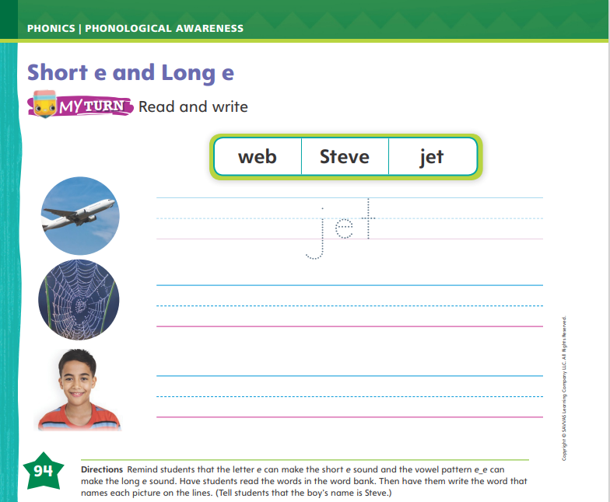
Page 94
Apply
Turn to page 94 in your Student Interactive and complete the activity.
Notes:
Have students turn to p. 94 in the Student Interactive. Listen carefully as I say the sounds: /e/ /e/ /e/, /ē/ /ē/ /ē/. Now let’s look at the first picture on page 94. It is a jet: /j/ /e/ /e/ /e/ /t/. We have learned all the sounds in jet. Can you find the word jet in the box? Guide students as they write jet on the line.
Have students complete the rest of p. 94 in the Student Interactive.

Slide 21
High-Frequency Words
black
brown
white
Notes:
Tell students that high frequency words are words that they will hear and see over and over in texts.
Write and read the words black, brown, and white.
Have students read each word.
Have students spell each word, slapping their knees as they say each letter.

Slide 22
Page 106
Preview Vocabulary
Notes:
Read the words farm, visit, and pumpkin on p. 106 in the Student Interactive. As you read each word, have students point to the word and say it with you.
Have students use the pictures and background knowledge to share what they already know about the words.
Ask questions to help clarify meaning: What can you see on a farm? Where would you like to go for a visit? What can you do with a pumpkin?

Slide 23
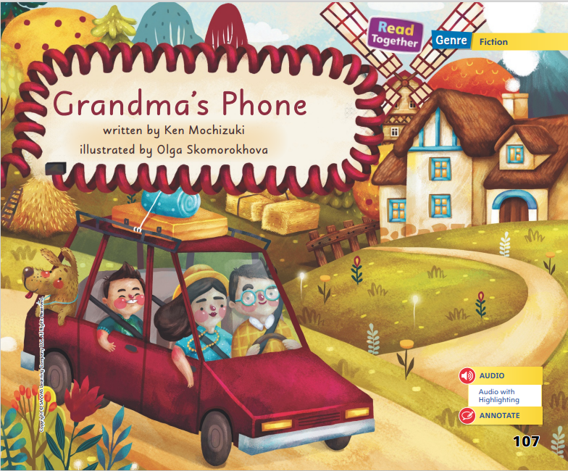
Page 107
First Read Strategies
Notes:
Discuss the First Read Strategies. In this first read, ask students to read for understanding and enjoyment.
First Read Strategies
READ Read or listen to the text. During the first reading, work to understand what the text is about.
LOOK Look at the pictures to help understand the text.
ASK Generate, or ask, questions about the text to deepen understanding.
TALK Talk to a partner about the text.
Help students read the whole text independently, in pairs, or as a whole class. Use the First Read notes to help students connect with the text and to monitor comprehension.

Slide 24
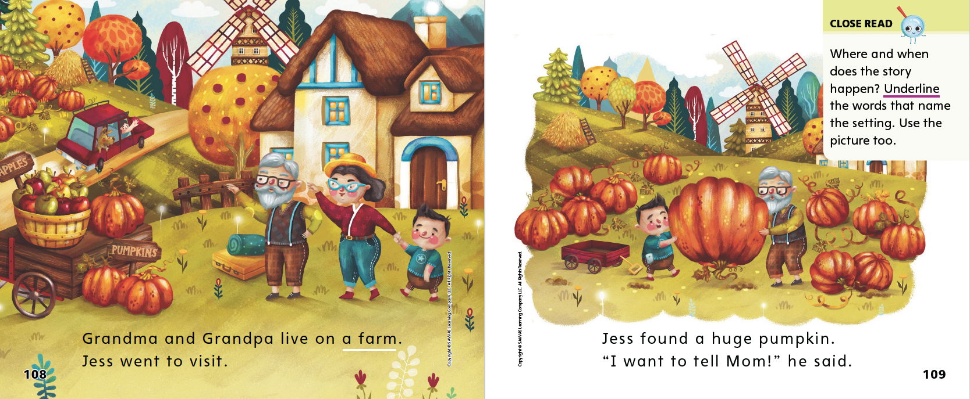
Page 108, 109
First Read – Grandma’s Phone
Notes:
Read Together.
THINK ALOUD THINK ALOUD: Before I begin reading, I like to look at the pictures to see what they can tell me about the story. In these pictures, I can see that there is a little boy with two older people. These are the characters in the story. The pictures also give me an idea of the setting, or where the story happens. It looks like a farm. As I read, I can see if the ideas I got from the pictures match the text.
Continue looking at the illustrations throughout the selection with students. Ask them what they think is happening on each page.

Slide 25
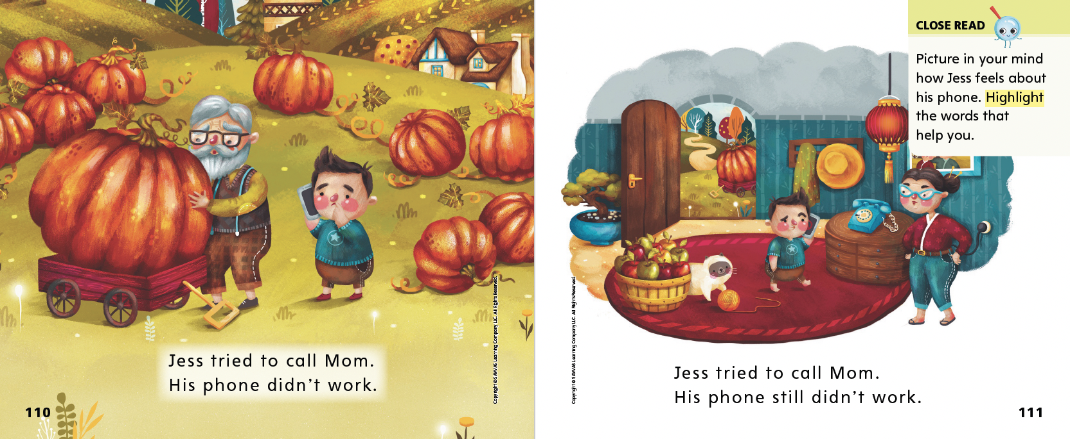
Page 110, 111
First Read – Grandma’s Phone
Notes:
Read Together.

Slide 26
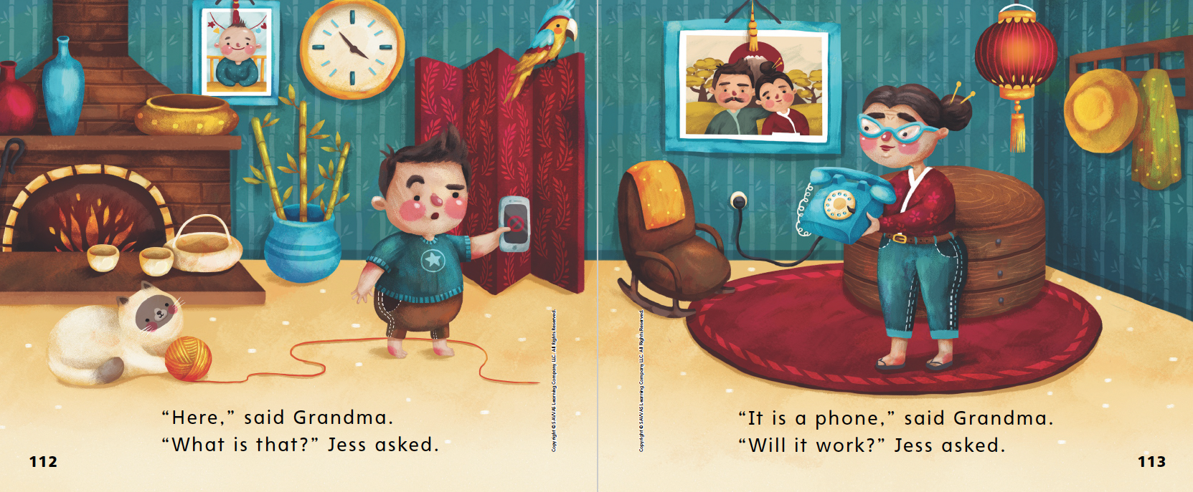
Page 112, 113
First Read – Grandma’s Phone
Notes:
Read Together.
THINK ALOUD The story makes me laugh! Jess really wanted to call his mom and tell her about the pumpkin. But when he finally uses Grandma’s phone to get through to her, all he can talk about is the phone.
Ask students to share with a partner how they felt as they read these pages.

Slide 27
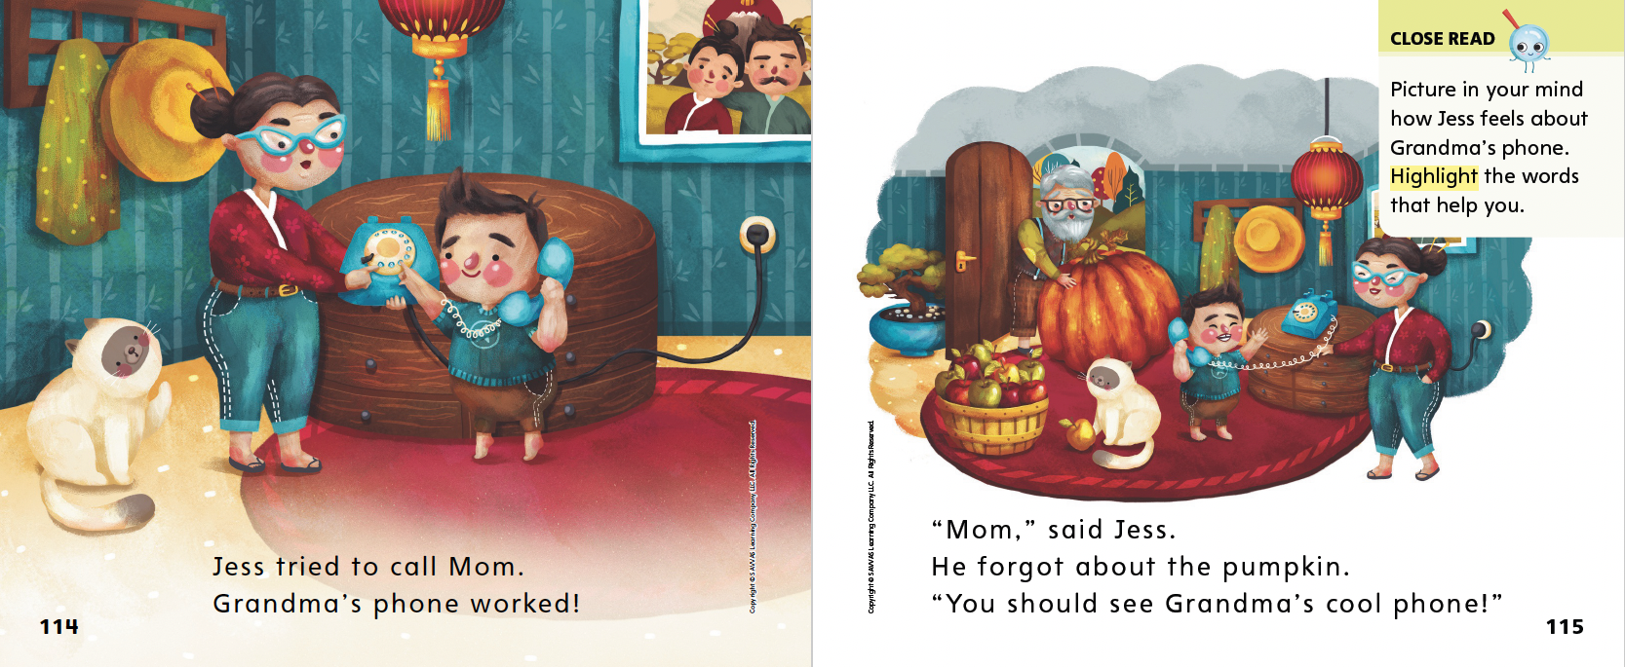
Page 114, 115
First Read – Grandma’s Phone
Notes:
Read Together.

Slide 28
Respond and Analyze
Brainstorm: What problem did Jess have?
Illustrate: Draw what happened in the story.
Notes:
Prompt students’ initial responses to Grandma’s Phone.
Brainstorm What problem did Jess have?
Illustrate the Story Draw what happened in the story.

Slide 29
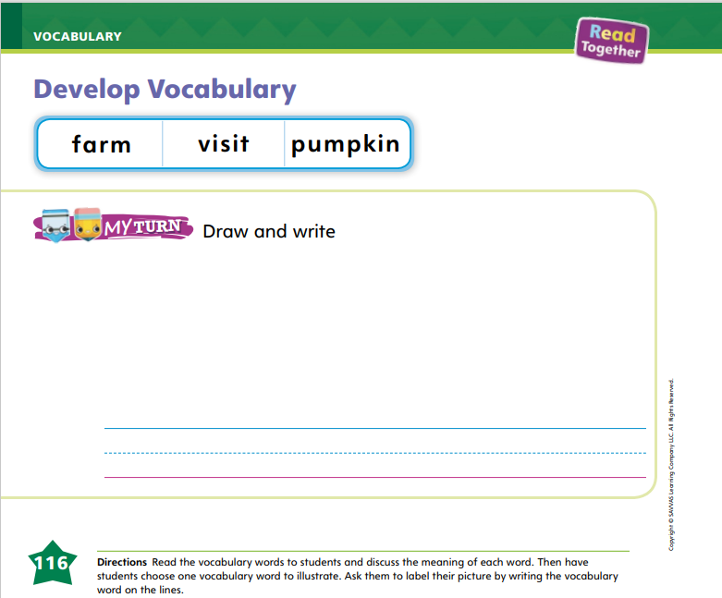
Page 116
Develop Vocabulary
Turn to page 116 in your Student Interactive and complete the activity.
Notes:
Explain to students that illustrations in a story can give us clues about the meaning of unfamiliar words. To learn or clarify word meanings, students can:
Read carefully to find the vocabulary words, and see if the text helps students understand what the words mean.
Look at the illustrations to see what clues they contain about the words.
Ask themselves or someone else questions to discover what a vocabulary word means and how it is used.
Have students look at pp. 108–109 to find the three vocabulary words. Read aloud the sentences with them when they find the words. I use the picture to make sure I understand and can use the words correctly. Ask students to choose one of the words. Have them talk to a partner about what they see in the pictures that helps them learn or clarify the meaning of the word.
Have students complete p. 116 in the Student Interactive by drawing one of the vocabulary words and writing the word.

Slide 30
Page 117
Check for Understanding
Turn to page 117 in your Student Interactive and complete the activity.
Notes:
Have students complete the Check for Understanding on p. 117 of the Student Interactive.

Slide 31
Writing – Personal Narrative
What happens first in the story?
What happens next?
What words does the author use to show the next event?
Notes:
Authors must keep the action going in their stories so that readers will keep reading. The middle of a personal narrative tells what happens next in the plot.
Tell students that authors think through the events in a narrative before writing. After the first event, there is another event. Sometimes, the events are separated by the words next or then. Read a stack text aloud. Point out what happens first, and then identify what happens next. Do a Think Aloud as you wonder what will happen after that.
Use another stack text to have students identify the first and next events. Engage students in a discussion to identify the words the author uses to show the next event.

Slide 32
Independent Writing
Continue working on your personal narrative.
Use words like next and then to show the order of events.
Notes:
Have students continue working on their personal narratives. Tell them to use words like next and then to show the order of events.
Writing Support
Modeled - Read a stack text aloud and point out what comes after the first event or problem.
Shared - Have students identify the second event in a stack text.
Guided - Ask questions to help students identify the events in their stories.
Have a few students share their drawings and narratives with the class. Prompt discussion on how the first event relates to the next event.

Slide 33
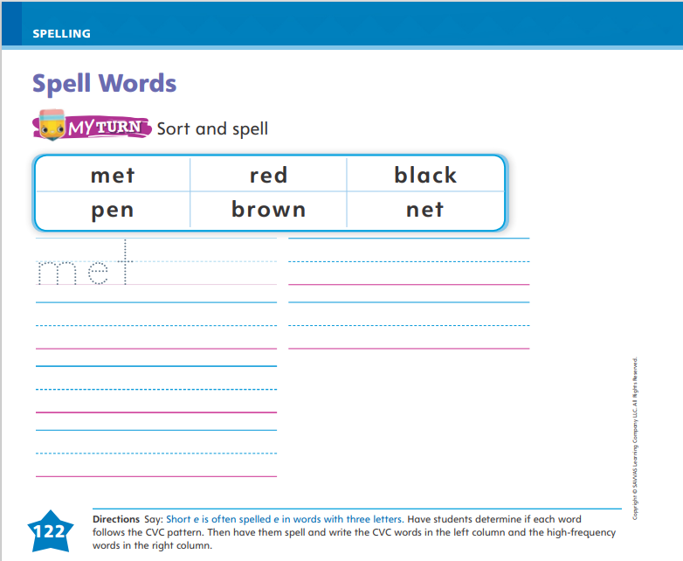
Page 122
Spelling
Turn to page 122 in your Student Interactive and complete the activity.
Notes:
Tell students that the short e sound can be spelled with the letter e. Point out that words with this sound are often spelled with the consonant vowel-consonant, or CVC, pattern. Then tell students that they can also use letter-sounds they know to help them spell high-frequency words.
Write or display these words with the CVC pattern: met, red. Say each word aloud and point out that these words have the short e sound. Then model spelling the high–frequency words by pointing out letter-sounds that students know.
Have students complete the activity on p. 122 of the Student Interactive.

Slide 34
Language and Conventions
I want to go home
Can I go home
We won the game
What kind of sentence is it?
What punctuation is needed?
Notes:
Explain that sentences need end punctuation. The punctuation depends on the type of sentence.
Display the following sentence without punctuation: I want to go home. Read the sentence and say: This is a telling sentence. A telling sentence needs a period at the end.
Repeat with the sentences Can I go home and We won the game. Ask students to read each sentence with you, tell what kind of sentence it is, and what punctuation is needed.
Ask students to work with a partner to say a telling sentence, a question, and an exclamation.

Slide 35
Lesson 3

Slide 36
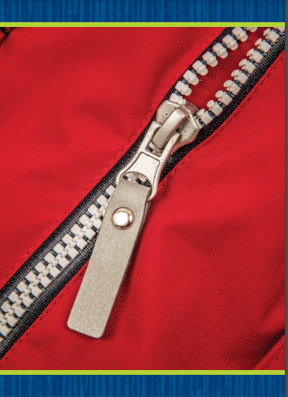
Page 95
Phonological Awareness
Turn to page 95 in your Student Interactive.
Notes:
Say: Today we are going to do some more work with syllables. Who remembers what a syllable is? Students should say a word part.
Display the zipper Picture Card. This is a picture of a zipper. Listen as I segment, or break apart, the syllables in zipper: zip (pause) per. How many syllables do you hear in zipper? (two) What is the first syllable in zipper? Yes, it is zip. What is the last syllable in zipper? Yes, it is per. Now let’s blend the syllables zip and per together to say the word: zipper. Repeat the routine using the following words: turkey, horse, turtle, dog.
Have students point to the picture of the kitten on p. 95 in the Student Interactive. This is a picture of a kitten. Let’s segment, or break apart, the syllables in kitten: kit (pause) ten. What is the first syllable in kitten? (kit) What is the last syllable in kitten? (ten) Guide students as they blend the syllables to say the word kitten. Have students continue with the other picture words on the page and circle the picture words with two syllables.

Slide 37
Phonics
eve
net
Notes:
Tell students that the letter e can make the sound /e/ and that the pattern e_e can make the sound /ē/.
Hold up the pen Picture Card. Tell students that it is a picture of a pen and that pen has the middle sound /e/. Write the word eve on the board. Show students that there is a vowel e, then a consonant, and then another e. Tell them that this pattern, e_e, makes the long vowel sound /ē/.

Slide 38
Page 96
Apply
Turn to page 96 in your Student Interactive and complete the activity.
Notes:
Have students turn to p. 96 in the Student Interactive. Have students trace the vowel or vowels in each word and identify the vowel sound. Then model the activity using the word net. I can say the sound each letter spells in this word: /n/ /e/ /t/. This word is net. Let’s circle the picture of the net in the first row.
Have students complete the activity on p. 96.

Slide 39
Page 97
High-Frequency Words
Turn to page 97 in your Student Interactive and complete the activity.
Notes:
Say: Today we will practice reading the high-frequency words black, brown, and white. Have students read the words at the top of p. 97 in the Student Interactive with you: black, brown, white.
Have students look at the words at the top of p. 97. Say: I will read a word, and I want you to point to it. Then we will read the word together. Read black, and have students point to it. Now let’s read the word together: black. Repeat with the other words.
Have students read the sentences on p. 97 with you. Ask them to identify and underline the words black, brown, and white in the sentences. Then have them read the sentences with a partner. Have students write one of the words on the lines.

Slide 40
Page 107
Describe Setting
Notes:
Explain to students that describing a story’s setting is telling where and when it takes place. Often, looking at pictures in the story can help you figure out where and when the story happens. To describe the setting of a story, students can:
Look at the pictures for details about the place where the characters are. Is it inside or outside? Is it like a familiar place?
Read to find important words that tell where and when a story is happening.
Use pp. 108–109 of the Student Interactive to model how to identify setting in a story.
When I look at the text on p. 108, I notice that the text tells me the setting: Grandma and Grandpa live on a farm.
The illustrations help me know what the setting is. I see fields with pumpkins, a wagon, and a haystack in the distance. This shows a farm. I know that it is autumn because the trees have colored leaves. It is also daytime because I can see that it is light outside.
Direct students’ attention to the Close Read note on p. 109. Have them underline the words and identify the parts of the picture that indicate what the setting is.

Slide 41
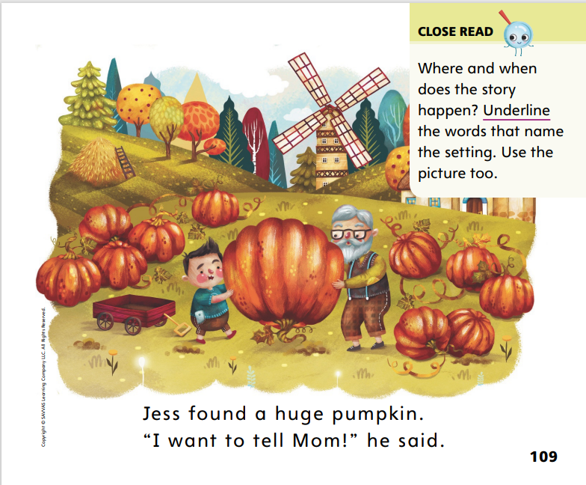
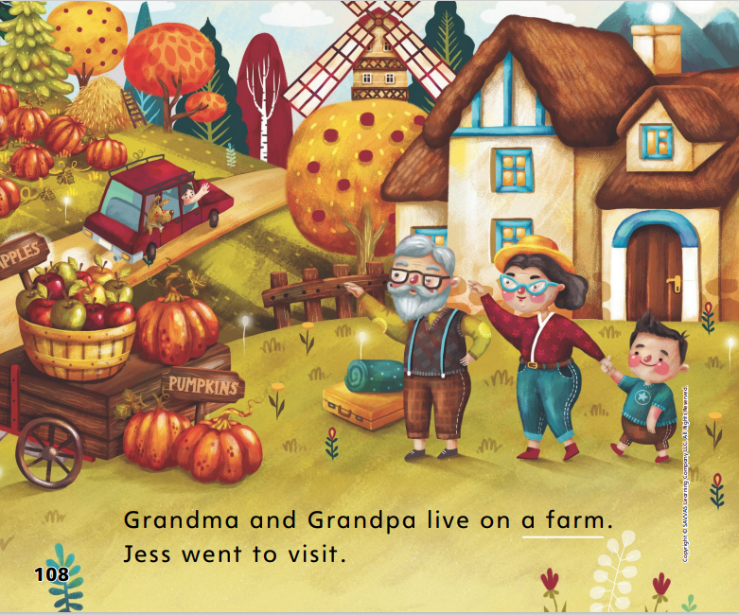
Page 108, 109
Close Read – Describe Setting
Turn to page 108-109 in your Student Interactive.
Notes:
Read aloud the Close Read note on p. 109. Then have students underline the words in the text that tell the setting. DOK 1

Slide 42
Page 118
Describe Setting
Turn to page 118 in your Student Interactive and complete the activity.
Notes:
Have students use the strategies for describing setting.
Have students complete the activity on p. 118 of the Student Interactive. Have them talk about the pictures with a partner.

Slide 43
Page 123
Read Like a Writer, Write For a Reader
Turn to page 123 in your Student Interactive and complete the activity.
Notes:
Explain that third-person text is written by a narrator, or storyteller, who is not a character in the text.
When the narrator of the story uses pronouns such as he, she, and they, the story is likely written in the third person.
Have students listen to and experience third-person text as you read aloud p. 109 in the Student Interactive. Model identifying the text as third-person. Jess found a huge pumpkin. “I want to tell Mom!” he said. The person telling the story is not in the story. This is a third-person text. Ask students which word helps them know that this text is a third-person text.
Have students complete p. 123 in the Student Interactive.

Slide 44
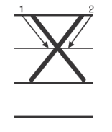
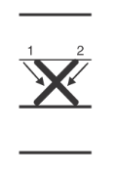
Handwriting
Notes:
Display uppercase and lowercase letters Xx. Ask students to name the letters and tell which is an uppercase letter and which is a lowercase letter.
Model writing the letters on the board. The uppercase and lowercase letter x are both written the same way. The difference is that the uppercase X is bigger. I start an uppercase letter X at the top line. I write a slanted line to the bottom. Then I pick up my marker and start again at the top line. I make another slanted line to the bottom, crossing over the first line.
Have students trace uppercase X in the air and then on their hands. Repeat with lowercase x, explaining that lowercase x starts at the middle line instead of the top line.
Have students use Handwriting p. 205 from the Resource Download Center to practice writing Xx. Click path: Realize -> Table of Contents -> Resource Download Center -> Handwriting Practice -> U4W3L3 Handwriting Practice

Slide 45
Page 126
Writing – Personal Narrative
Turn to page 126 in your Student Interactive and complete the activity.
Notes:
Tell students that the middle of a personal narrative tells what happens next.
Read a stack book aloud and have students identify each event. Encourage students to use words like then and next when giving the order of events.
Then write a personal narrative that students can relate to, for example, your first day of kindergarten or losing a tooth. Tell students your idea and let them know you will write a personal narrative about it. Model writing a personal narrative. Point out the beginning and then focus on what happens next. Explain to students that the middle of a story tells what happens next.
Have students decide on a personal narrative they will write as a class. Ask students what happens first, next, and last. Transcribe their events into a narrative.
Direct students to complete p. 126 in the Student Interactive.

Slide 46
Independent Writing
Review what you have written.
Think about your sequence of events.
How can you improve your writing?
Share your personal narrative with class.
Notes:
As students transition into independent writing, have them think about their sequence of events. If they have composed the beginning and middle of their personal narrative already, have them reread and improve them.
Writing Support
Modeled - Walk through a stack text with students to help them identify the order of events.
Shared - Have students dictate the middle of their narrative as you transcribe.
Guided - Ask students questions to help them add details to the middle of their stories.
Then they should continue writing their personal narratives.
Have a few students share their stories with the class. Encourage discussion about the sequence of events.

Slide 47
Spelling
j
e
t
Notes:
Review how to spell CVC words with short e.
Give each student three cards with the letters j, e, t. Have students arrange the letter cards to spell the word jet. Remind them to use what they know about the CVC pattern for short vowel words.
Have students complete Spelling p. 212 from the Resource Download Center. Click path: Table of Contents -> Resource Download Center -> Spelling -> U4W3

Slide 48
Language and Convention
Jen wants to win
Can Jen win
Jen won the race
When do we use a question mark?
When do we use a period?
When do we use an exclamation point?
Notes:
Discuss what type of punctuation to use with different types of sentences. Ask: When do we use a question mark? When do we use a period? When do we use an exclamation point?
Display the following sentences without punctuation: Jen wants to win; Can Jen win; Jen won the race. The first sentence tells me what Jen wants. It is a telling sentence, so it needs a period. The second sentence asks if Jen will win, so it is a question and needs a question mark. The third sentence tells about something exciting that happens. It needs an exclamation point.
Display sentences without punctuation, for example: Watch out, I need a new pencil, Where are you going. Ask students to copy the sentences and use the correct punctuation.
For additional help with teaching end punctuation, see the Language Awareness Handbook.

Slide 49
Lesson 4

Slide 50
Page 98
Phonics
Turn to page 98 in your Student Interactive and complete the activity.
Notes:
Display the pen Picture Card. Point to the picture of the pen. This is a picture of a pen. I hear the sound /e/ in the word pen. Tell students that the sound /e/ is spelled with the letter e and that the e_e pattern can spell the sound /ē/. Have students trace an e in the air as they chorally say /e/ and then /ē/.
Have students turn to p. 98 in the Student Interactive. Ask them to name the first picture. (bed) Then have them write the word bed on the lines. Finally, have them read the word.
Have students complete p. 98 in the Student Interactive.

Slide 51
Page 99
Decodable Story
black
brown
white
Turn to page 99 in your Student Interactive. We will Read “Jen and Pete.”
Notes:
Have students turn to p. 99 in the Student Interactive. We are going to read a story today about a girl and a boy. Point to the title of the story. The title of the story is Jen and Pete. I hear the sound /ē/ in the name Pete. What other sounds that we learned do you hear in the word Pete? Students should come up with /p/ and /t/. In this story, we will read other words that have sounds you have learned.
Remind students of this week’s high-frequency words: black, brown, white. Tell students that they will practice reading these words in the story Jen and Pete. Display the words. Have students read them with you. When you see these words in the story Jen and Pete, you will know how to identify and read them.
Have students whisper read the story as you listen in. Then have students reread the story page by page with a partner. Listen carefully as they use letter-sound relationships to decode. Partners should reread the story. This time the other student begins.
After students have read the story, call their attention to the title. I see the pattern e_e in this word: Pete. What sound does the pattern e_e spell? Help them identify, or say, the sound /ē/. Then have them find and highlight the word with the sound /ē/ in the title on p. 99. I also hear other sounds we have learned in the sentences on this page. There is another word with the sound /ē/. Guide students as they highlight the name Pete in the first sentence.

Slide 52
Page 100, 101
Decodable Story
Notes:
Have students turn to pp. 100–101. Which words include the sound /e/? Point to them. Help students identify, or say, the sound /e/.
Have them underline the words with the sound /e/.

Slide 53
Page 107
Visualize Details
Notes:
Tell students that good readers visualize, or create mental images, as they read. Explain that picturing the characters, settings, and events in their minds can help them better understand a story. Tell students there are strategies they can use to help them visualize.
Pay attention to words the author uses that tell about the characters, settings, and events.
Picture the characters in your mind. What do they look like? What do they do?
Picture the setting. What does it look like? What time is it?
Picture the events. Pretend you are watching them happen.
Have students look back at pp. 108–109 in the Student Interactive. I read that Grandma and Grandpa live on a farm. I also read that the farm has pumpkins. The words farm and pumpkins help me visualize, or picture in my mind, where Grandma and Grandpa live. I picture a home with lots of farmland around it. I picture pumpkins growing there.
Ask students to use the Close Read notes on pp. 111 and 115 in the Student Interactive to find and highlight words that help them visualize what is happening in the story. Discuss the words students highlighted. Provide assistance as necessary

Slide 54
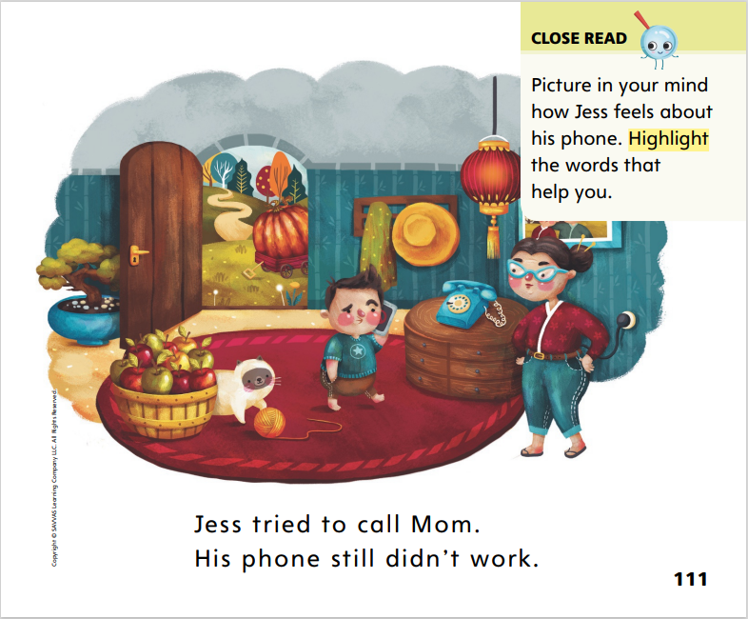
Page 111
Close Read – Visualize Details
Turn to page 111 in your Student Interactive.
Notes:
Read with students the Close Read note on p. 111. Tell students to highlight words that help them picture how Jess feels. DOK 2

Slide 55
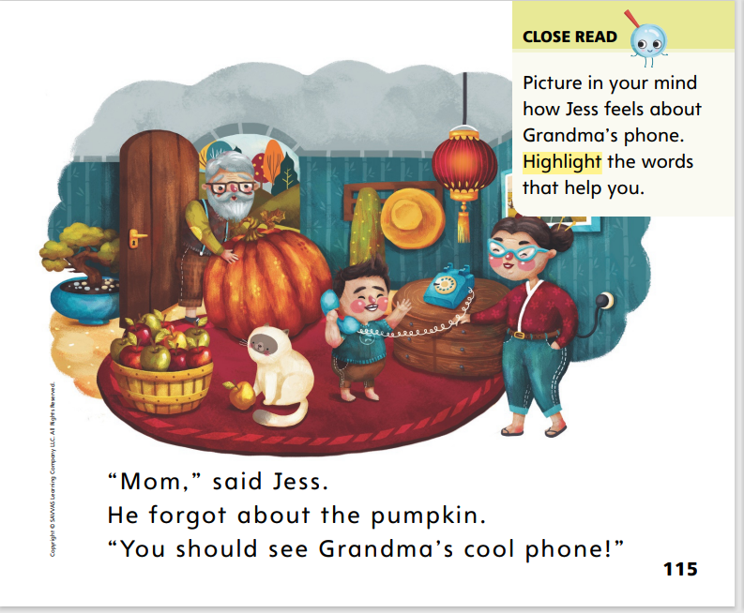
Page 115
Close Read – Visualize Details
Turn to page 115 in your Student Interactive.
Notes:
Remind students that the words in a text can help us picture the story in our mind. Read aloud the Close Read note on p. 115.
Ask students to close their eyes and visualize as you read aloud p. 115 again. Have one or more students tell what they pictured. DOK 2

Slide 56
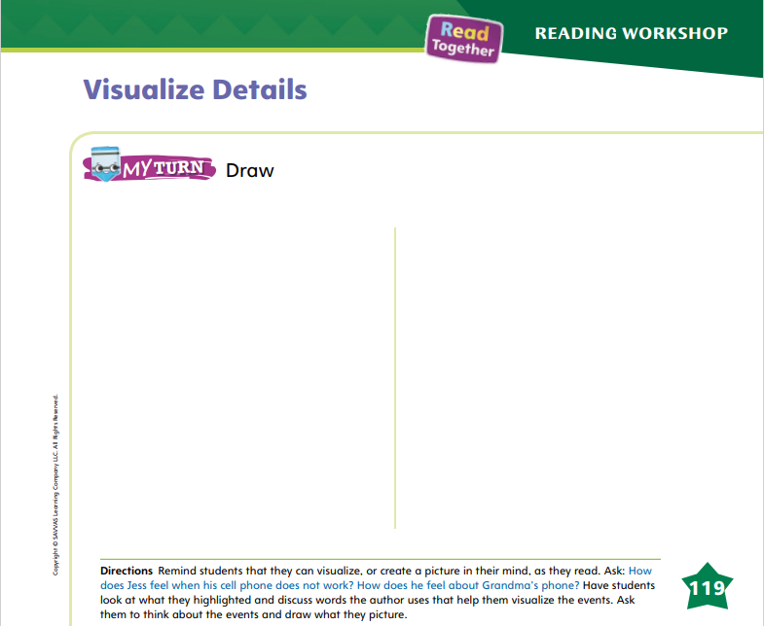
Page 119
Visualize Details
Turn to page 119 in your Student Interactive and complete the activity.
Notes:
Have students use the strategies for visualizing details.
Have students complete their drawings on p. 119 of the Student Interactive.

Slide 57
Writing – Personal Narrative
Ending Event
Notes:
A personal narrative has an ending event, or conclusion. The event that happens last tells how the problem from the beginning of the narrative is solved.
Thumb through a stack text. Look at the pictures, telling what you see. Focus on the last pictures in the book. Point out how they relate to the first. Think aloud as you draw conclusions about what happens last in the story. Read the text aloud, commenting on the first, next, and last events. Explain to students that the last event ends the narrative. It tells how a problem is solved or what happens to a character.
Have students practice identifying the ending of a narrative. Read a stack text aloud, and have students identify the first, next, and last events. Prompt a discussion about how the events in the narrative are connected and how the narrative ends.
Choose another stack book and read the first and middle events. Be sure the first event introduces the problem. We’re going to plan an ending for this book. What is the problem? How can we write an ending that will solve the problem?
Write students’ ideas on a flipchart or board. Then tell students they will plan an ending to their own narratives. To help students get started, call on a few students to describe the problem in their narrative and how the problem was solved in real life. Ask the class to discuss how the ending could tell the resolution to the problem.

Slide 58
Independent Writing
Write the ending of your narrative. The ending should tell how the problem is solved.
Share your ending with the class.
Notes:
After this lesson, students should transition into independent writing. Have them work on their narrative’s ending. Remind students that the conclusion of the narrative should tell how the problem is solved.
Writing Support
Modeled - Think aloud about an ending to a narrative.
Shared - Tell students to talk about their ending ideas as you transcribe their notes.
Guided - Prompt students to identify what would be a good ending to the narrative.
Ask a few students to share their endings with the class. Prompt students to explain why they chose their ending and how it solved the problem.

Slide 59
Spelling
but
fun
rug
cup
Notes:
Remind students that CVC words with the sound /u/ are spelled with the letter u.
Display letters, such as foam letters or letters on construction paper, for the words but and fun. Say the word but and ask a volunteer to arrange the letters to spell the word. Have students spell the word together as the volunteer points to the letters in order. Continue with the word fun.
Arrange students in groups of three, and give each group the letters for a CVC word, such as rug or cup. Have each group work together to spell a CVC word with their letters. Then have them share their word with the group and spell it aloud.

Slide 60
Page 124
Language and Conventions
Turn to page 124 in your Student Interactive and complete the activity.
Notes:
Have students complete the practice activity on p. 124 in the Student Interactive.

Slide 61
Lesson 5

Slide 62
Phonological Awareness
pencil
ruler
reading
marker
backpack
recess
How many syllables are in each word?
Notes:
Today we are going to talk more about syllables. Listen carefully as I say this word: pencil. How many syllables are in the word pen (clap) cil (clap)? Yes, there are two. What is the first syllable in pencil? Students should say pen. What is the second syllable in pencil? Students should say cil.
Listen carefully as I say this word: ruler. How many syllables are in ru (clap) ler (clap)? Yes, there are two. What is the first syllable in ruler? Students should say ru. What is the second syllable in ruler? Students should say ler.
Say the following words: reading, marker, backpack, recess. Have students clap the syllables in each word, tell you how many syllables the word has, and identify the syllables.

Slide 63
Phonics
Eve
Steve
e
e_e
set
Ben
Pete
red
Notes:
Write the letter e and the pattern e_e on the board. Have students identify the letters as you point to them. Then review the sound spellings for the letter and pattern: e /e/ and e_e /ē/.
Give each student a card with e on the front and e_e on the back. Then write the word Eve on the board. We will read this word together. If you hear the sound /e/, hold your card with the letter e facing the front of the room. If you hear the sound /ē/, hold your card with the pattern e_e facing the front of the room. Keep your card on your lap if the middle sound in the word isn’t /e/ or /ē/. Repeat with the words man, Steve, set, Ben, Pete, mix, and red.

Slide 64
Page 102, 103
Apply
Turn to page 102, 103 in your Student Interactive and complete the activity.
Notes:
Have students turn to p. 102 in the Student Interactive and read the sentences with a partner.
Have students look at p. 103 in the Student Interactive. Have them read the sentences.
Ask them to circle the words with the sound /e/ and underline the words with the sound /ē/.

Slide 65
High-Frequency Words
brown
black
white
Notes:
Remind students that high frequency words are words that appear over and over in texts. Remind them that they will be learning many of the words this year, and the words will help them become better readers.
Say the word brown and ask students what letters spell the word.
Have students
say the letters as you write the letters on the board.
say and spell the word, clapping their hands for each letter.
repeat with black and white.

Slide 66
Page 120
Reflect and Share
Turn to page 120 in your Student Interactive and complete the activity.
Notes:
Involve students in a discussion about how cars and phones have changed over time. Base the discussion on a comparison of Cars Are Always Changing and Grandma’s Phone. Suggest that students ask questions about the texts as they compare and discuss. • How are the two texts alike? How are they different?
What do the texts tell us about old cars and phones?
What do the texts tell us about new cars and phones?
According to the texts, how have cars and phones changed?
Model providing an oral response by comparing and contrasting details about cars and phones from the texts. I read in Cars Are Always Changing that old cars did not go very fast. Cars today can go much faster. Jess tries to use a cell phone outside in Grandma’s Phone. Grandma’s older phone can’t be taken outside. I learned that new cars and phones can do some things that old cars and phones couldn’t do.
Ask students to respond to the text by talking to a partner about how phones and cars have changed.
Have students use the Turn and Talk prompt on p. 120 in the Student Interactive to talk about the texts with a partner.

Slide 67
Page 120
Apply
How has communication changed over time?
Discuss your answer with your group.
Notes:
Have students use evidence from the texts they have read this week to respond to the Weekly Question.
Tell them to discuss in small groups or write or draw their responses on a separate sheet of paper.

Slide 68
Page 127
Writing – Personal Narrative
Turn to page 127 in your Student Interactive.
Notes:
A personal narrative has an ending event, or conclusion. The event that happens last tells how the problem is solved. Authors of personal narratives also include a reaction to what happened to tell how they felt.
Choose one of the stack books to discuss in more detail, and display a simple sequence chart. As you discuss the events, fill in the chart. As students remember, record their responses.
Choose one of the stack books to discuss in more detail. Point out how the story is organized. First, the problem is introduced. Then more events happen. These events tell what the character is doing to solve the problem. Finally, the problem is solved. A narrative ends with a resolution.
Tell students: Authors organize the events by putting them in the order in which they happened. It would be confusing if the author told how the problem was solved before the characters started trying to solve it. When you write your narratives, you will write the events in the order they happened in real life. You will end by telling how the problem was solved. After the problem is solved, write how you felt about it.
Tell students that using an organizer such as a sequence chart can help them plan their narratives. They can draw what happens first, what happens next, and what happens last.
Direct students to organize ideas in pictorial form on p. 127 in the Student Interactive.
Have one or two students read their personal narratives aloud to the class. When they are finished reading, prompt the students to identify what happened to the character or how a problem was resolved at the end of the book.

Slide 69
Spelling
The ball went over the net.
The table is brown.
The red light means to stop.
We have a black car.
Mom met her favorite author.
The pen is out of ink.
Notes:
(Note: Move the orange boxes to cover each bold spelling word before you read aloud the words and sentences.)
Read aloud the words and sentences. Have students spell each word with initial consonant blends and the two high-frequency words.
The ball went over the net.
The table is brown.
The red light means to stop.
We have a black car.
Mom met her favorite author.
The pen is out of ink.
Reveal the spelling word and have students check their work.

Slide 70
Language and Conventions
Is that your cat
Which end punctuation do we need for this sentence?
.
?
!
Notes:
Display the following sentence and guide students to choose the correct punctuation. (1) Is that your cat
What end punctuation do we need for this sentence?
.
?
!
Have students complete Language and Conventions, p. 218 from the Resource Download Center. Click path: Table of Contents -> Resource Download Center -> Language and Conventions -> U4 W3

Slide 71
Unit 4: Week 3
Grade K

